Slide 1
Papers detail
SIN DALYA
25-08-2023

Slide 2
Content
An Empirical Comparison of LM-based Question and Answer Generation Methods
Dataset
Evaluation T5 large result
Implementation idea

Slide 3
Dataset
SQuADShifts (lmqg/qg_squad)
(train/valid/test):
train: 75,722
Valid: 10,570
Test: 11,877
Average character length (paragraph/sentence/question/answer)
Paragraph: 757
Sentence: 179
question 59
answer 20
Dataset: https://huggingface.co/datasets/lmqg/qg_squad
For more detail on model and traning dataset:
https://github.com/asahi417/lm-question-generation/blob/master/QG_BENCH.md

Slide 4
Dataset
Train Dataset Structure:
{ "question": "What is heresy mainly at odds with?",
"paragraph": "Heresy is any provocative belief or theory that is strongly at variance with established beliefs or customs. A heretic is a proponent of such claims or beliefs. Heresy is distinct from both apostasy, which is the explicit renunciation of one's religion, principles or cause, and blasphemy, which is an impious utterance or action concerning God or sacred things.",
"answer": "established beliefs or customs",
"sentence": "Heresy is any provocative belief or theory that is strongly at variance with established beliefs or customs .",
"paragraph_sentence": "<hl> Heresy is any provocative belief or theory that is strongly at variance with established beliefs or customs . <hl> A heretic is a proponent of such claims or beliefs. Heresy is distinct from both apostasy, which is the explicit renunciation of one's religion, principles or cause, and blasphemy, which is an impious utterance or action concerning God or sacred things.",
"paragraph_answer": "Heresy is any provocative belief or theory that is strongly at variance with <hl> established beliefs or customs <hl>. A heretic is a proponent of such claims or beliefs. Heresy is distinct from both apostasy, which is the explicit renunciation of one's religion, principles or cause, and blasphemy, which is an impious utterance or action concerning God or sacred things.",
"sentence_answer": "Heresy is any provocative belief or theory that is strongly at variance with <hl> established beliefs or customs <hl> .“
}

Slide 5
Dataset
The data fields are the same among all splits.
question: a string feature.
paragraph: a string feature.
answer: a string feature.sentence: a string feature.
paragraph_answer: a string feature, the same as the paragraph but the answer is highlighted by a special token <hl>.
paragraph_sentence: a string feature, the same as the paragraph but a sentence containing the answer is highlighted by a special token <hl>.
sentence_answer: a string feature, the same as the sentence but the answer is highlighted by a special token <hl>.

Slide 6
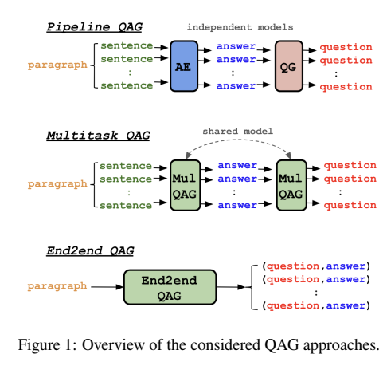
An Empirical Comparison of LM-based Question and Answer Generation Methods
answer extraction (AE) and QG
QAG generating a set of question-answer pairs given a context (e.g. a paragraph).
QA models fine-tuned on generated QA pairs can be competitive when compared to supervised QA models trained on human-labeled data.
Input: context such as a document, a paragraph or a sentence.
Output: a set of question-answer pairs
fine-tuned on both AE and QG jointly in a multitask learning
converting QA pairs into a flattened sentence and fine-tuning a seq to seq model
(generate y from c)

Slide 7
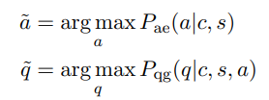
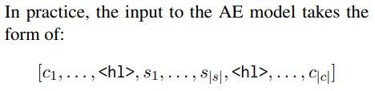

Detail Process: An Empirical Comparison of LM-based Question and Answer Generation Methods
Model: trained independently on any paragraph-level QG datasets (maximizing the conditional loglikelihood)
- generates an answer on a sentence in context.
- generates a question by answer in given context.
answer extraction (AE) and QG
<hl>is the highlighted token to mark the sentence in the context.
fine-tuned on both AE and QG jointly in a multitask learning
fine-tuned on both AE and QG jointly in a multitask learning
mix the training instances for AE and QG altogether
randomly sample a batch at each iteration of fine-tuning
Each subtask is distinguished by a task prefix added at the beginning of the input text: “extract answer” (AE) and “generate question” (QG).
converting QA pairs into a flattened sentence and fine-tuning a seq to seq model
(generate y from c)
model it by converting the question-answer pairs into a flattened sentence y
fine-tuning a sequence-to-sequence model to generate sentence y from context

Slide 8
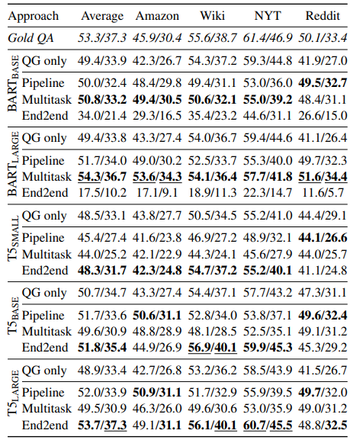
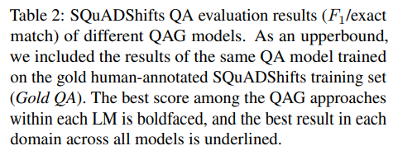
Experimentation : An Empirical Comparison of LM-based Question and Answer Generation Methods

Slide 9
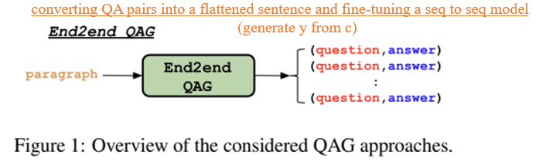
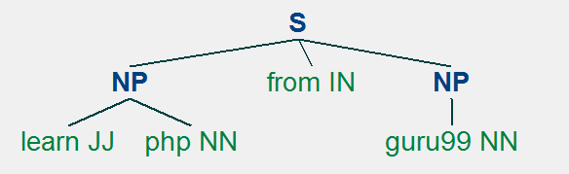
Implementation Idea
model it by converting the question-answer pairs into a flattened sentence y
fine-tuning a sequence-to-sequence model to generate sentence y from context
Question_generator model (focus on correctness of question):
Training: hint_sen,question pairs (Using trained model to generate question)
Test: generated questions automatically from the text.
Input:
articles
Output:
Question: create questions which are related to the sentence.
Answer: sentence tokens (POS pattern patterns of information from sentence).
Article
Question_generator model
QA pair
Example:
Sentence: learn php from guru99.

Slide 10
Thank You

